Slide 1
Your Mission: To educate others on the value of virtue ethics within the technology sector. Will you accept?
Tuesday February 18th
Introduction
Ethical Coding
The Value of Virtue Ethics
Also...If I act goofy it's because I taught middle school and this is my first time teaching college students. I have no idea what I’m doing and I can’t help but have fun!

Slide 2



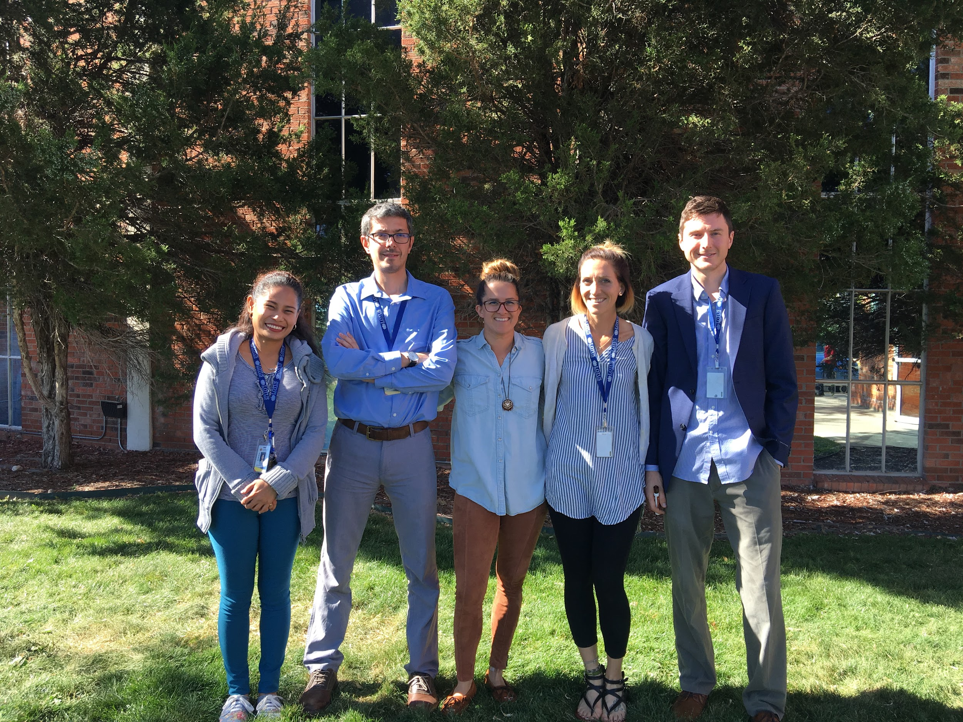
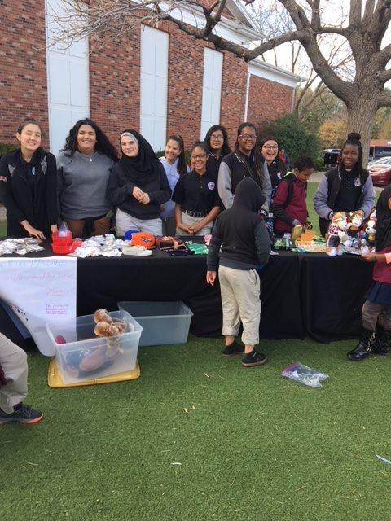
Introduction - Matt Turner
A.I. Ethics K-12 Evangelist for CU
Started as a MS/HS Teacher for Lotus School for Excellence
Amazing Diversity -
Over 40 Countries
46 Different Languages Spoken

Slide 3
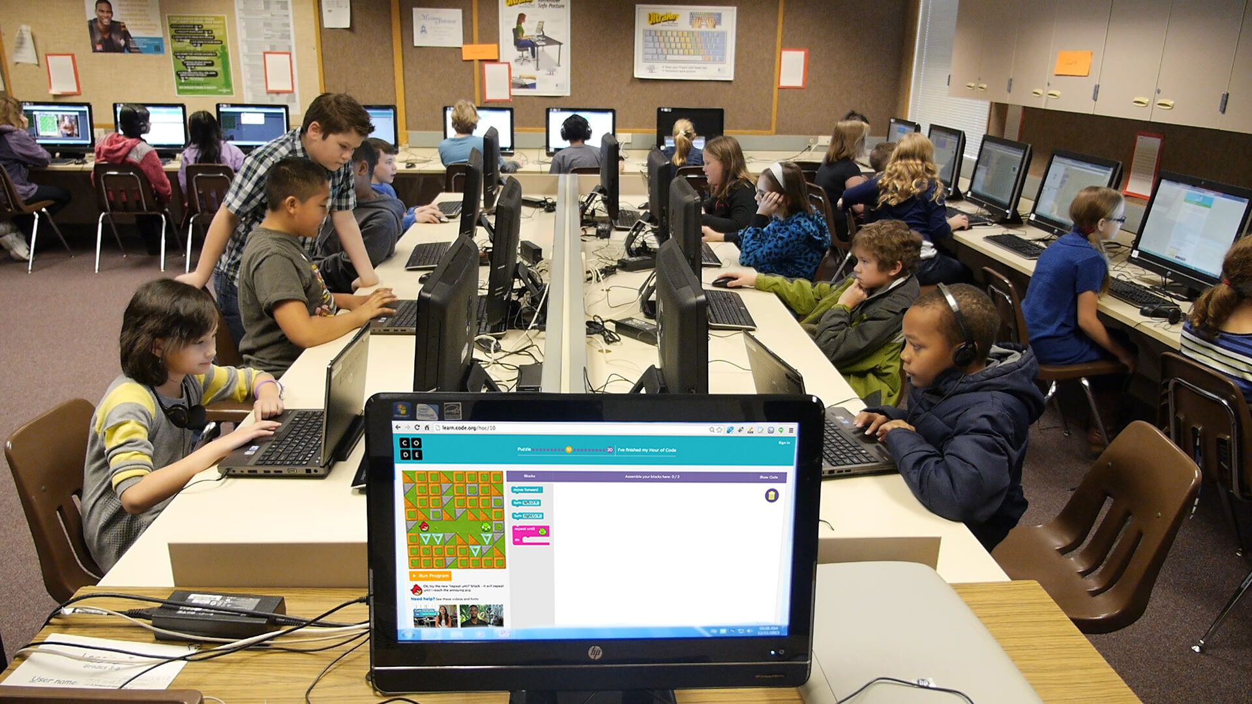
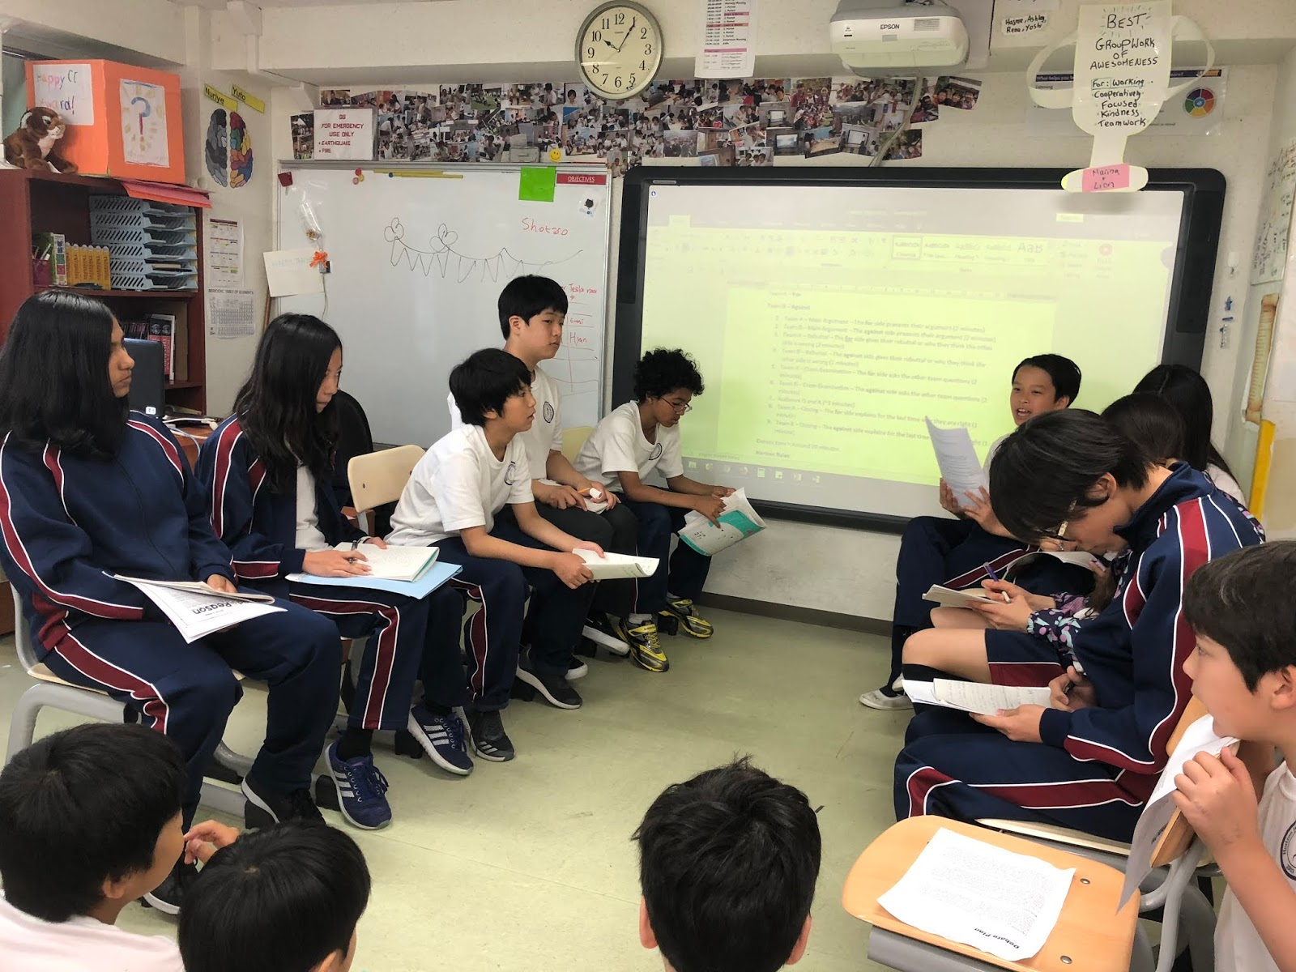
Where to teach about A.I., Big Data, & Ethics?
Computer science….or ALL classes?
Which is better suited for technical training...
Which is better suited for civic / artistic training....

Slide 4
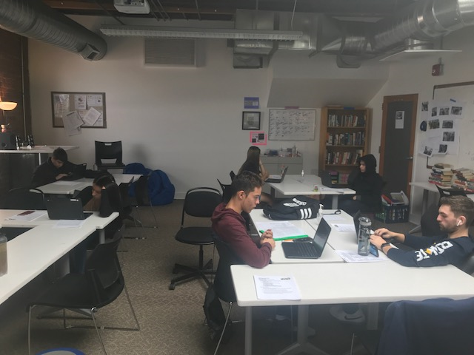
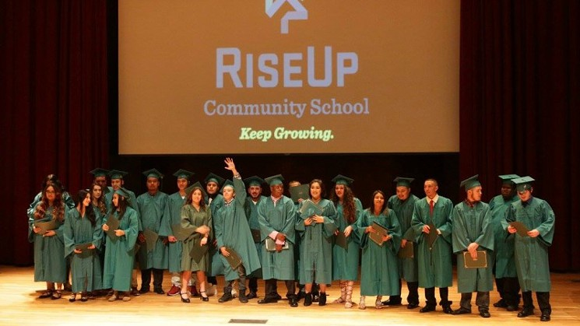

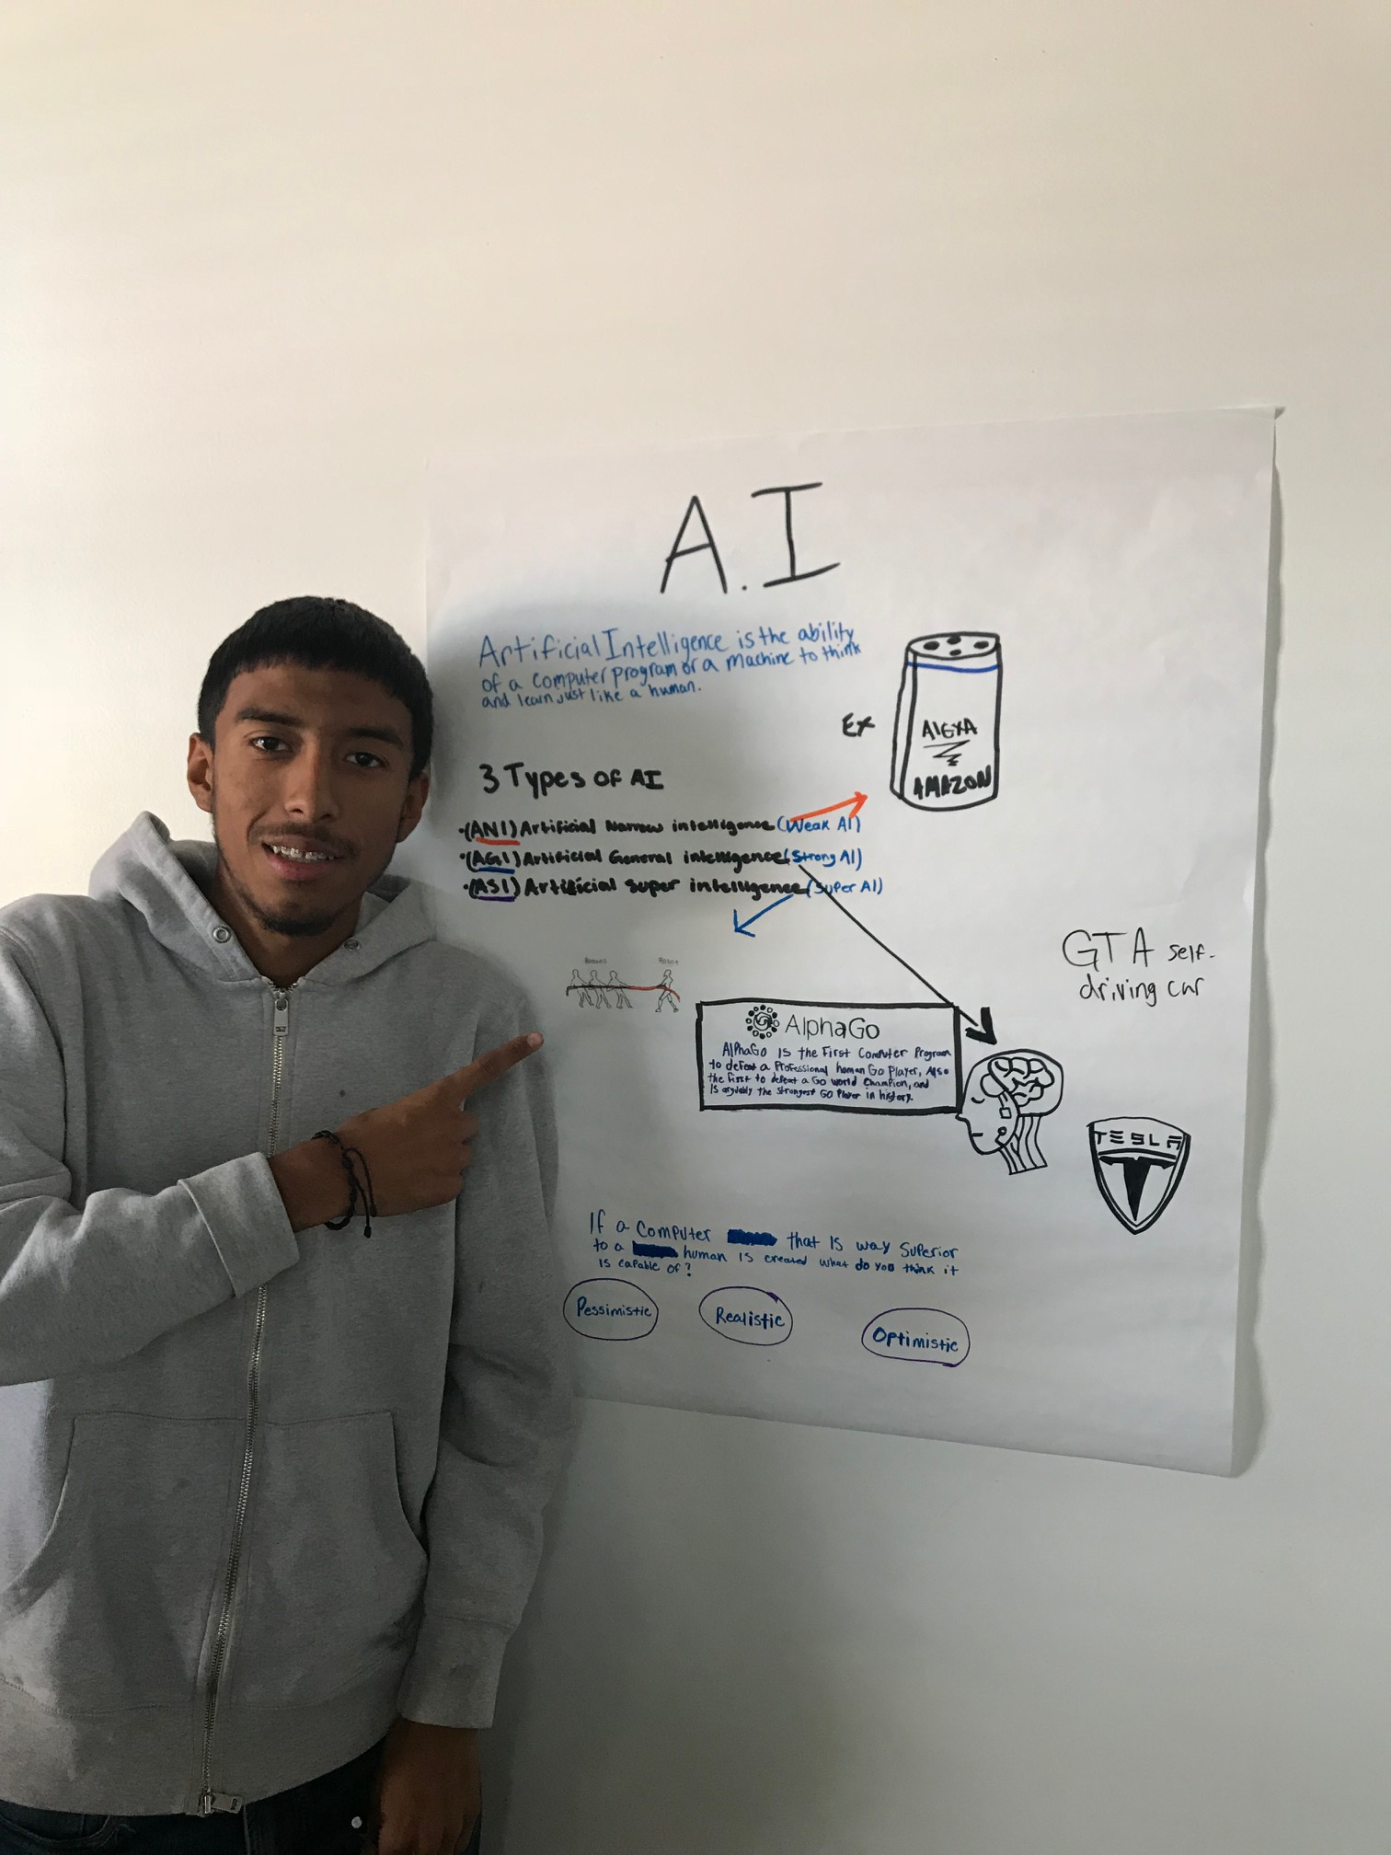
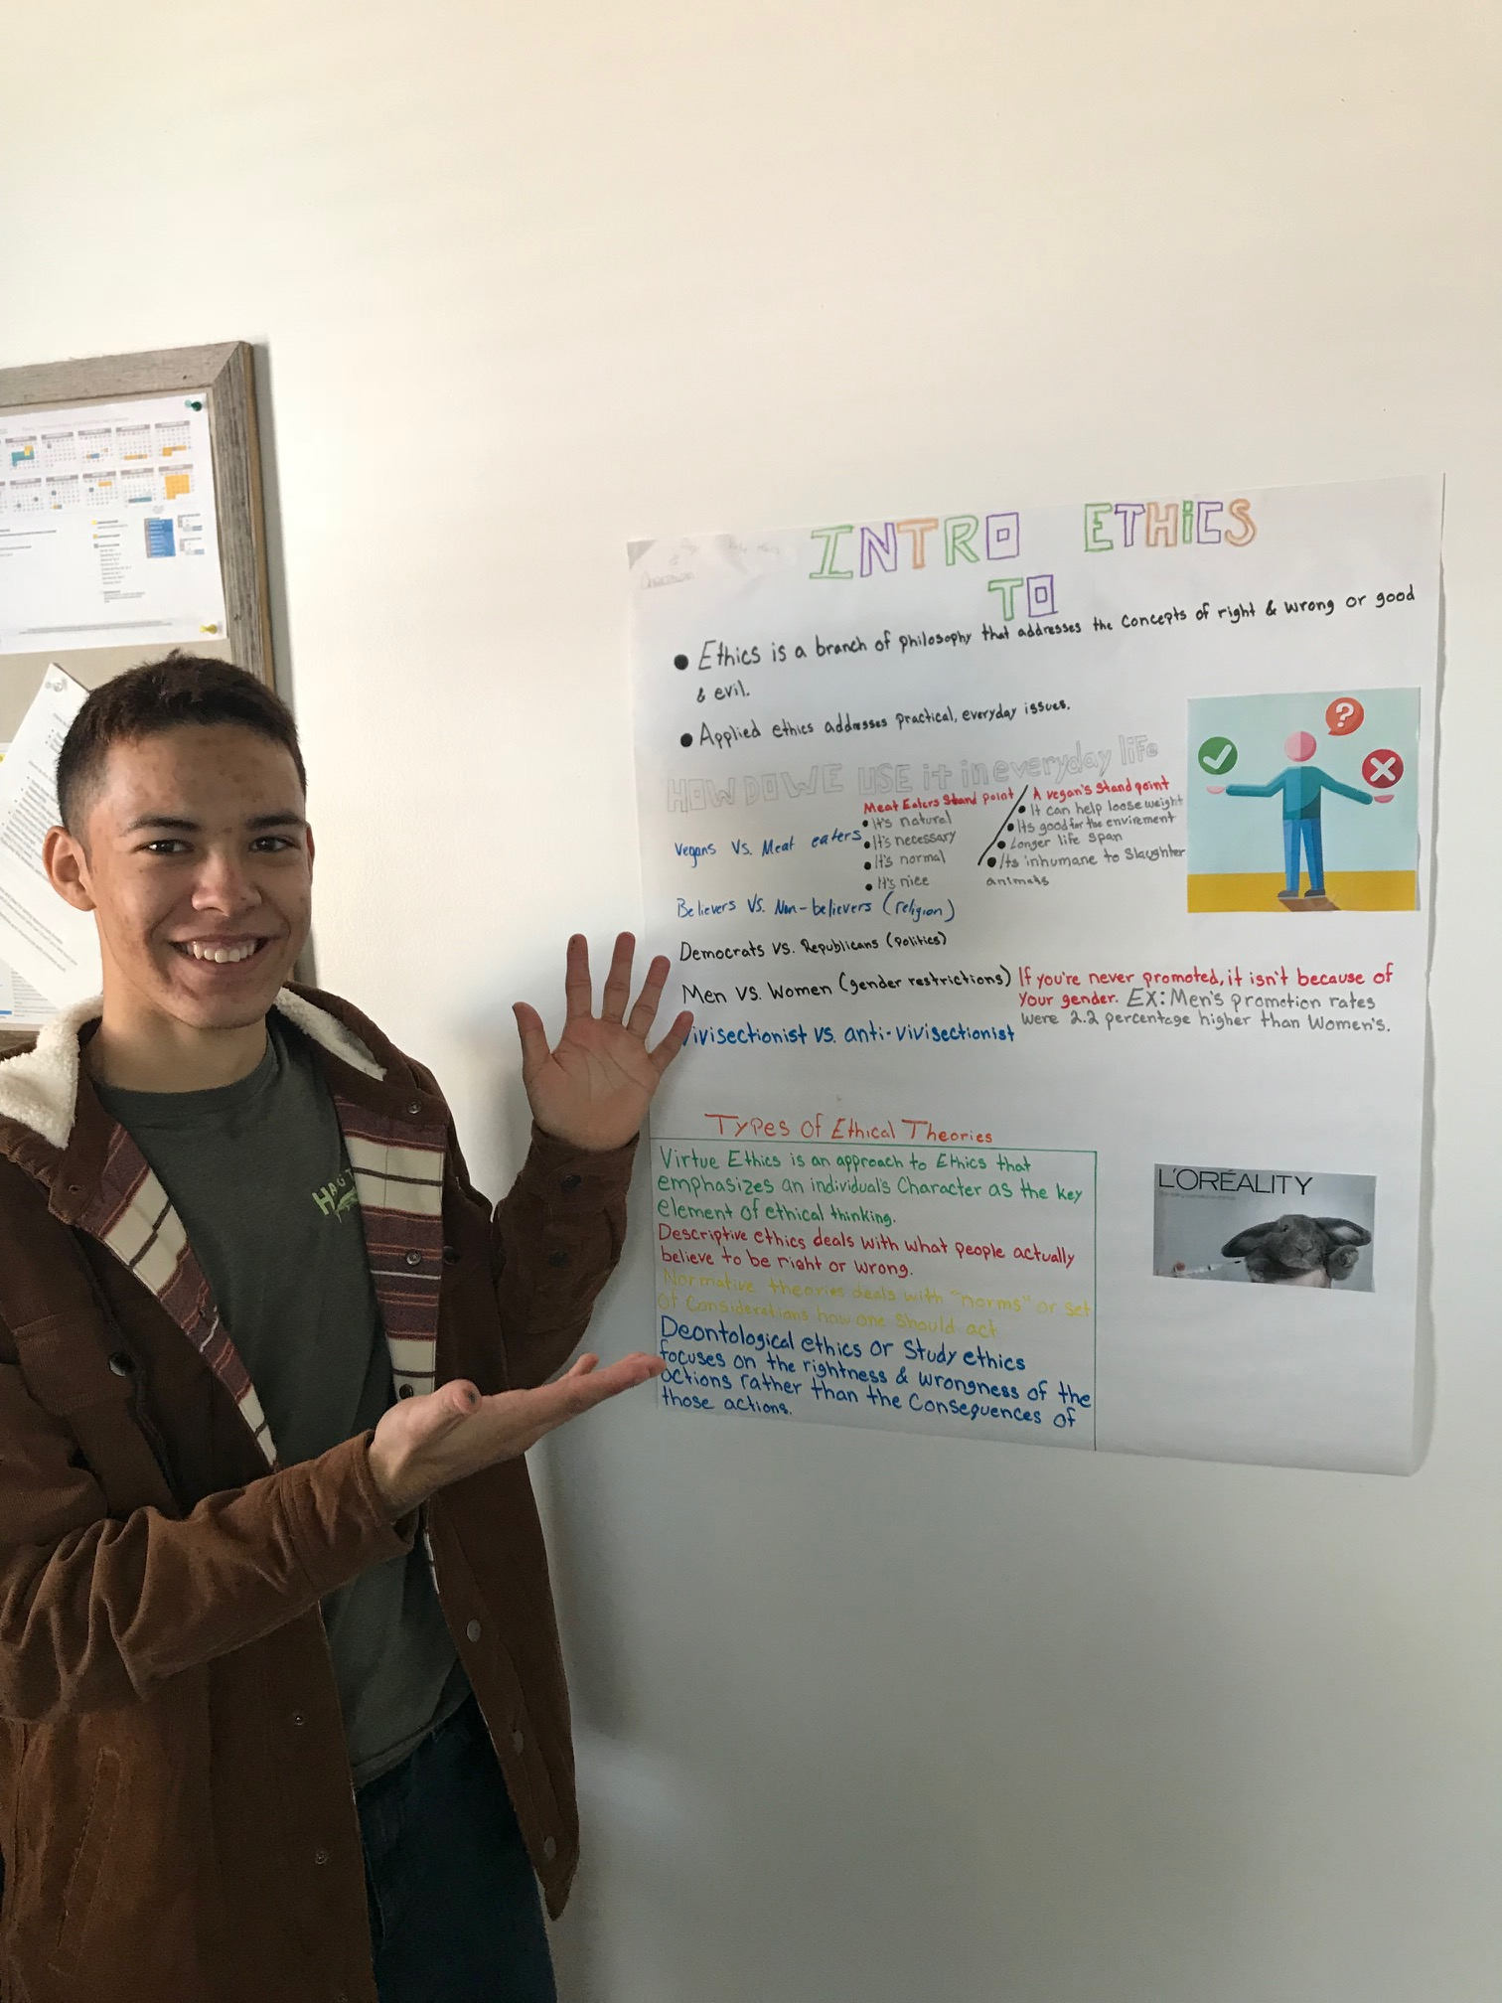

Rise Up Community School in Denver

Slide 5
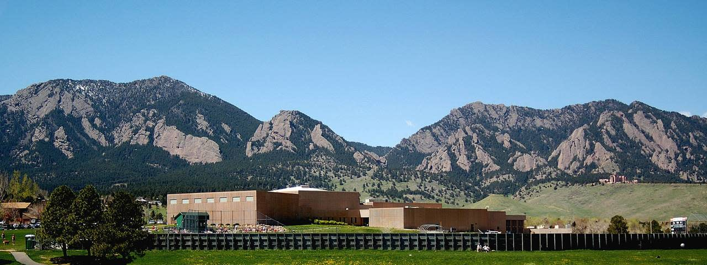
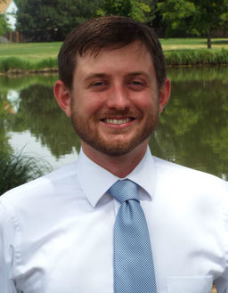

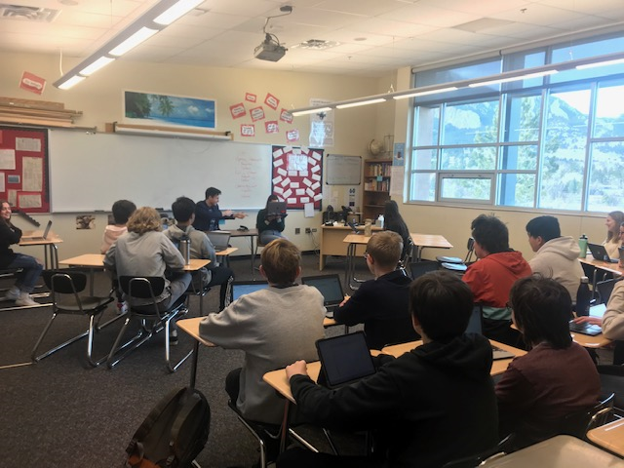
Fairview High School in Boulder
3 Periods of Students - 90 Kids Total
3 Seperate Social Science Projects
A.I. Moral Dilemmas
A.I. Court Cases
A.I. Applications

Slide 6
Student Feedback
94% of Students “Would Recommend to a Friend”
When asked why...this is what they said!
It would probably be useful for them to know about, even if they aren't interested in AI.
It's a great topic to learn about since there is a bigger demand for AI that can do things for us
This is a subject which is affecting us at this day and it is extremely important that our generation is informed about it.
The world of A.I. is ever approaching and in my opinion this unit should be necessary and taught to everyone.
I felt like a real person not just a student. and I actually know what is going on in the real world, there should definitely more classes like this.
This mini-unit was fun and enjoyable and Mr. Turner was a good teacher.
It was a nice change of pace from the stuff we had been learning and I thought it was fairly interesting.
Yes, because it was really fun over all and i would do it again.
I think having mini-units are interesting, it could allow people to learn about something currently going on.
A.I. is going to improve in the future, and it is important to know the ethics, fears, and possibilities behind future technology.
You still learn about history, but in a non direct way.
I think the unit was too short.
It was interesting to see the AI we currently have and how its being used in today's society.
It was interesting and important to learn before entering the new field of jobs and careers that this generation will face.
I think this would be super fun if we did multiple projects and if the unit lasted a little longer but overall, I enjoyed this unit.
It's one that my other classes never really talked about. I also thought that the the was he taught everything was really fun.
Yes, because it is very interesting to learn about society and the world's needs from this perspective of the A.I.
Because it's something we don't usually learn and it's really unpopular and cool.
I liked the aspect and honestly what we learned better than the other more bland units (in social science curriculum).

Slide 7
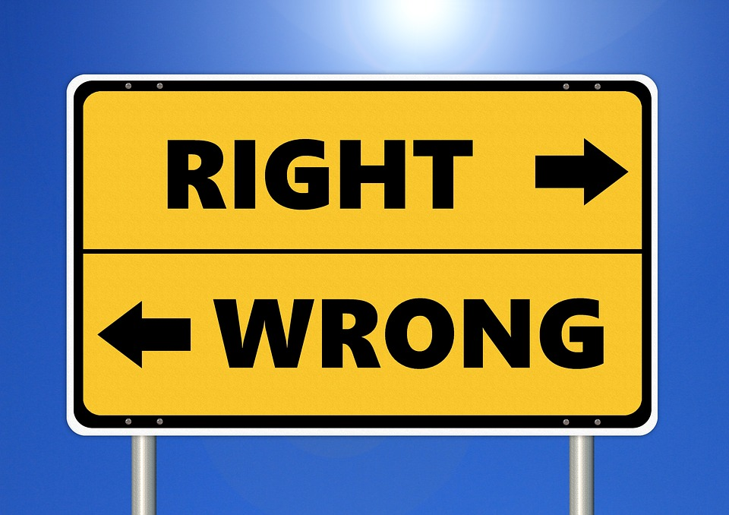


What I taught them I’m going to teach you!
...in under an hour :D (panics slightly)
From Human Moral Code
To Computer Code
To A.I. Moral Code
The primary question is this...what kind of moral or ethical code should we encode into a machine?

Slide 8
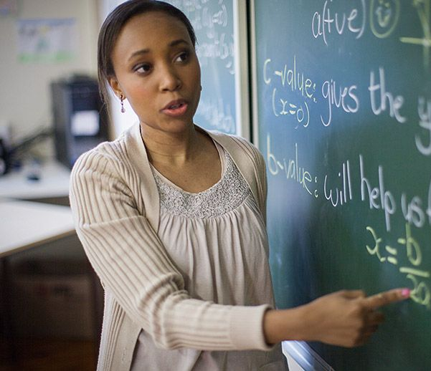
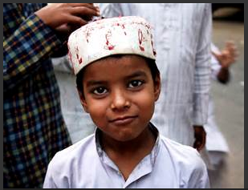

Which Human would you trust?
A. B. C.
Will punish those who do wrong and reward those who do right. Believes there is a right and a wrong.
Will always ask “why?” when making a choice. Believes in the gray. Does not believe in good or evil.
Will always choose the option that leads to the greatest good for the greatest number.

Slide 9
Construct your ethical code...remember this is your personal code. Try not to let others influence it!
Evil
Neutral
Good

Slide 10
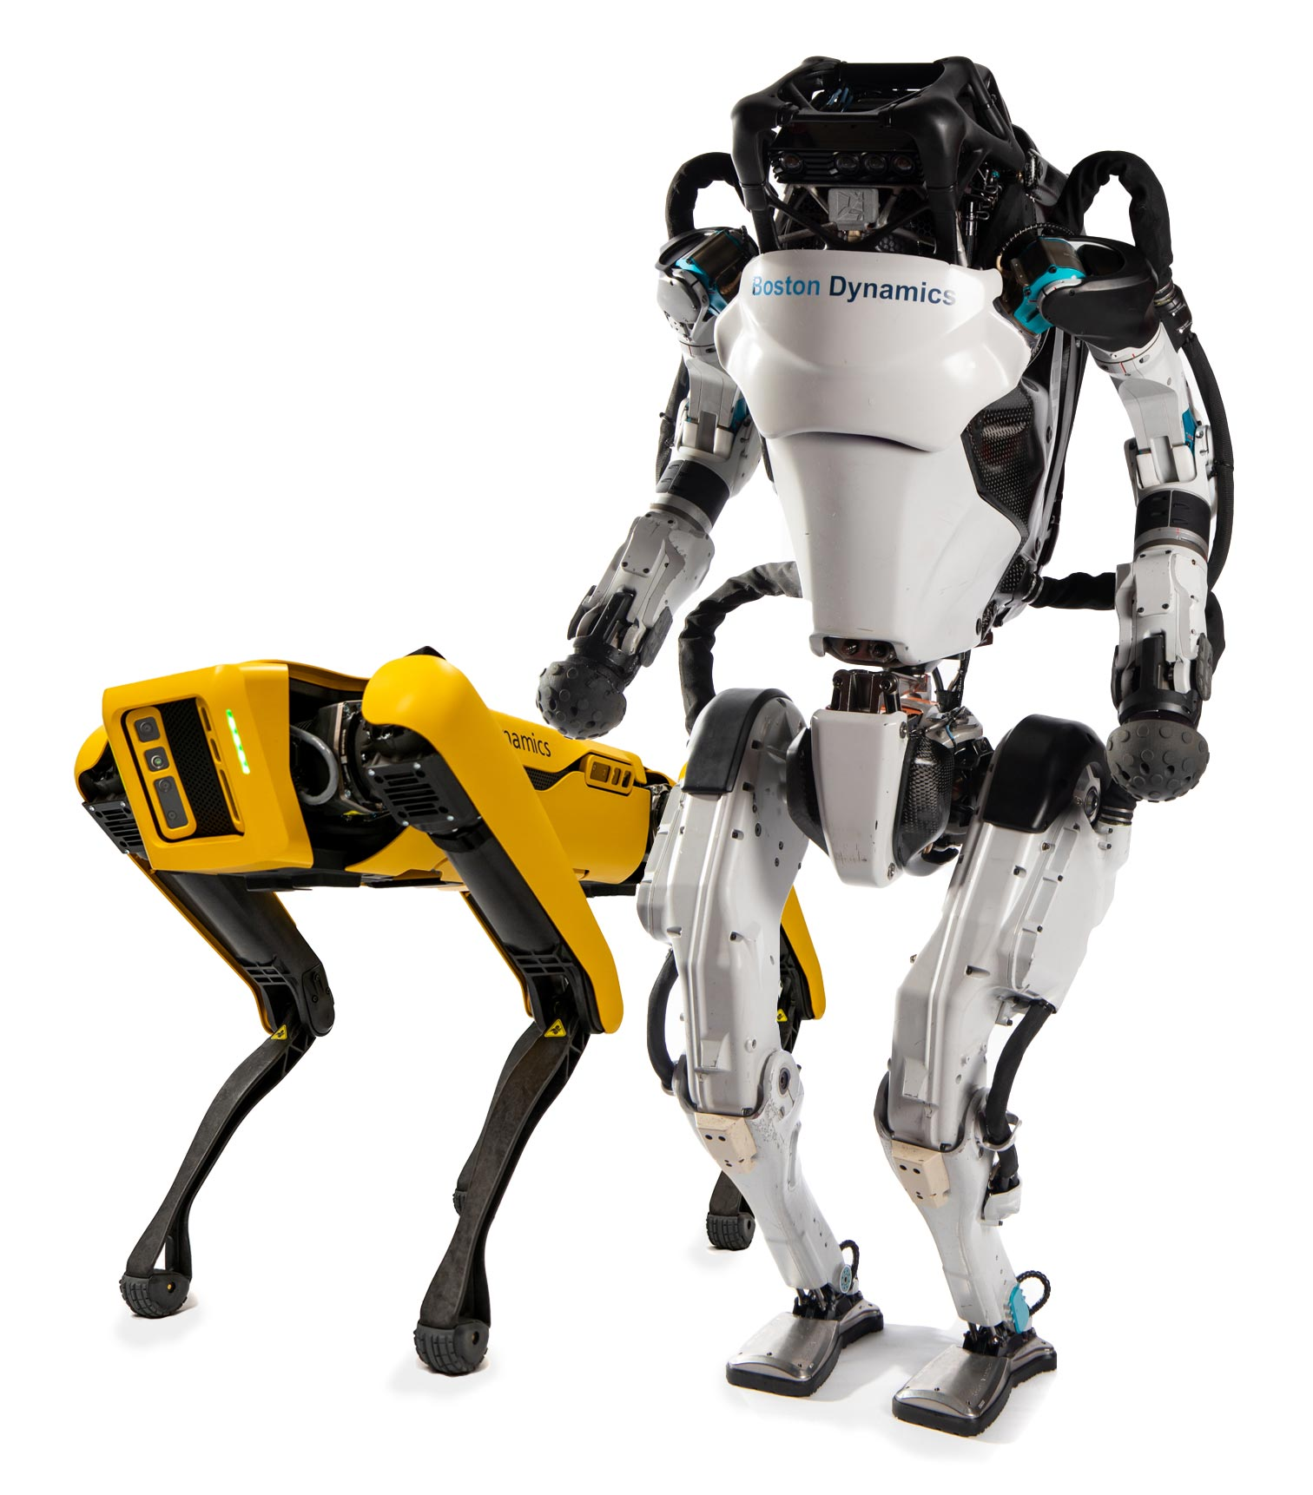
Which Robot would you trust?
A. B. C.
Will always choose the option that leads to the greatest good for the greatest number. Ex. Hires you because you are willing to be a slave for the company.
Will punish those who do wrong and reward those who do right. Believes there is a right and wrong. Ex. Hires you because you are NOT religious.
Will always ask “why?” when making a choice. Believes in the gray, not in good or evil. Ex. Hires you because your character is most likely going to help the company.

Slide 11
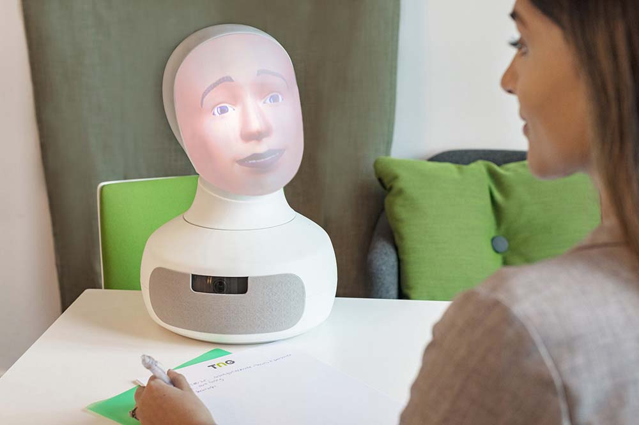
What does Robot C. really look like?
Meet Tengai - The Virtue Ethicist Robot

Slide 12
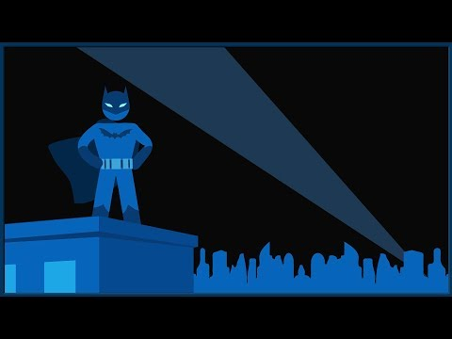
Quick Summary of Virtue Ethics

